Slide 1





Visual Perception using Deep-Learning and Its’ Application in Image Processing
Speaker: Dr. Vinit Jakhetiya
Date: 31 August, 2018
Assistant Professor, IIT Jammu

Slide 2
Outline
Introduction & Motivation
Six Problems Related to Visual Perception
Just-noticeable-difference estimation
Perceptually Motivated reconstruction algorithm : A Generic Framework
No-reference image quality assessment (IQA) for 3D synthesized images using Local descriptor
Reduced-reference IQA for screen content images using distortion categorization
No-reference IQA for natural imaging using distortion prediction and Deep-Learning for KoNiq-10K dataset.
No-reference IQA for 3D synthesized images using outlier prediction.
Conclusion

Slide 3
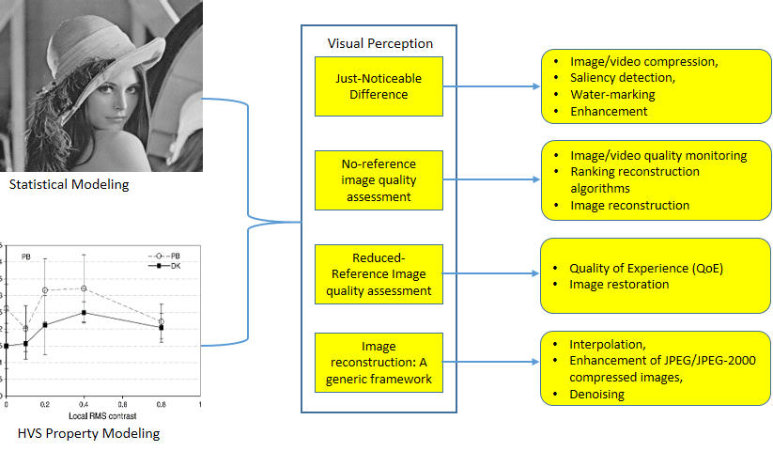
Introduction & Motivation
Notes:
In last decade, tremendous growth has been seen in the consumer electronics. Millions of photos and videos are captured everyday and humans are the ultimate receiver of these visual signals. With this view, it is required to learn how our human visual system works and model HVS. For example, our HVS is quite sensitive to smooth regions and can easily perceive small distortions in these regions. So, in this thesis, we have model the HVS and apply these models for the purpose of image quality assessment and JND.

Slide 4
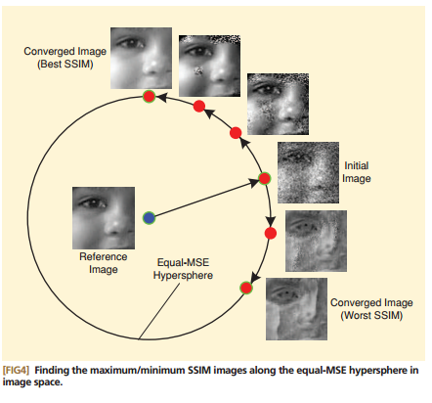
Introduction: Image Quality Assessment
PSNR = Peak Signal to Noise Ratio
SSIM [1] = Structure Similarity Index
[1]. Z. Wang et al., “Image quality assessment: from error visibility to structural similarity,” IEEE Trans. on Image Processing, pp. 600-612, 2004.

Slide 5
Introduction: Image Quality Assessment
Two approaches
Subjective evaluation
Most Reliable
Time-consuming, laborious, viewer-dependent, impractical in real-world scenarios.
Objective evaluation
Full-Reference (FR)- requires complete information about the reference image
Reduced-Reference (RR)- requires some information about the reference image
No-Reference (NR)- no other information is requires.
These IQA metrics are useful in following scenarios, such as
Matches with human vision and eliminate the need of subjective testing.
Quality monitoring and enhancing quality of experience (QoE).
Achieve better image/video reconstruction accuracy.

Slide 6



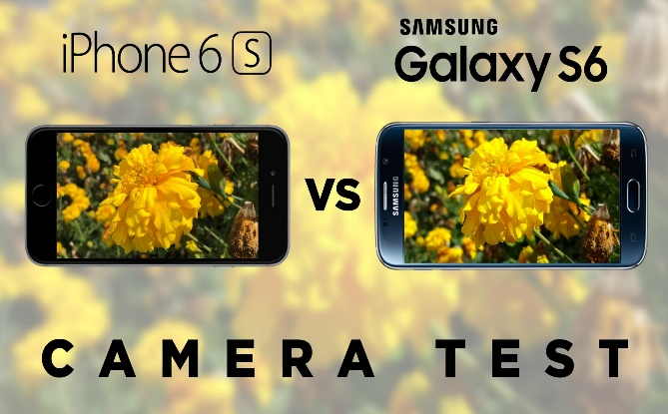
Applications of Visual Perception
Matches with human vision and eliminate the need of subjective testing. Particularly useful in cloud based image/video streaming.
** Some of the content of these slides are taken from the Google Images (with free to use or share license).

Slide 7
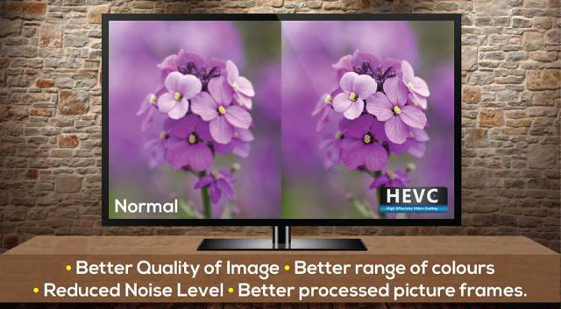
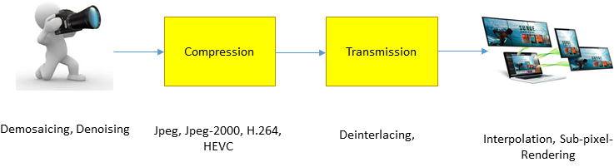
Applications of Visual Perception
Achieve better image/video reconstruction accuracy.
** Some of the content of these slides are taken from the Google Images (with free to use or share license).

Slide 8

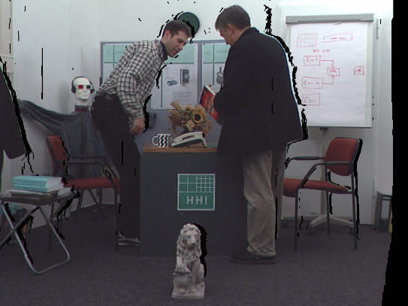
Motivation
Researchers have achieved a lot for IQA for natural images.
Is it a time to look beyond natural images?
Can IQA metrics designed for natural image judge 3D synthesized images and Screen Content images and if not why not?
Screen Content Image
3-D synthesized Image
Are IQA metrics only useful for judging the quality?

Slide 9
Outline
Introduction & Motivation
Six Problems Related to Visual Perception
Just-noticeable-difference estimation
No-reference image quality assessment (IQA) for 3D synthesized images using Local descriptor
Reduced-reference IQA for screen content images using distortion categorization
No-reference IQA for natural imaging using distortion prediction and Deep-Learning for KoNiq-10K dataset.
No-reference IQA for 3D synthesized images using outlier prediction.
Perceptually Motivated reconstruction algorithm : A Generic Framework
Conclusion

Slide 10

P1. Just Noticeable Difference (JND)
What is JND and Why it is useful?
JND help to identify perceptually important regions and so, it useful in several applications, such as:
Multimedia coding,
Quality assessment,
Water-marking,
Saliency detection, and
Visual enhancement.
Size=120 KB
Size=169 KB
Notes:
JND is a visibility threshold below which changes made in the signal can not be perceived by the 75% of the subjects.
Remove visually unimportant information

Slide 11
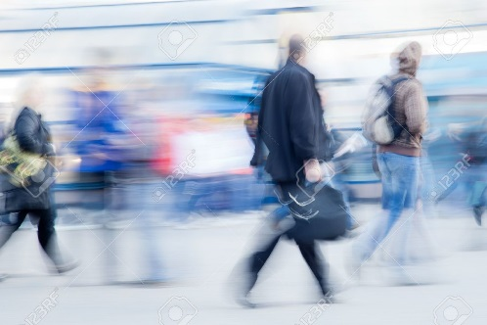

P1. Related Work
JND algorithms can be broadly divided into two categories:
Pixel domain JND
Frequency domain JND.
Table 1. Comparison between existing pixel domain JND models [1-5].
Luminance Adaptation
Attribute | Chou et al. [1] | NAMM [2] | Liu et al. [3] | Wu et al. [4] | Proposed [5]
LA or Texture Masking | Yes | No | No | No | Yes
LA and CM | No | Yes | Yes | Yes | yes
Image classification | No | No | Yes | No | Yes
CM based upon edge strength | No | Yes | Yes | No | Yes
CM based upon prediction errors | No | No | No | Yes | Yes
Contrast Sensitivity | No | No | No | No | Yes
Handle Under- and over-estimation of CM | No | No | No | No | Yes
Contrast Masking
[1]. C. H. Chou and Y. C. Li, “A perceptually tuned sub-band image coder based on the measure of just-noticeable-distortion profile,” IEEE Trans. on Circuits and Systems for Video Technology, pp. 467-476, 1995.
[2]. X. K. Yang, et al., “Just noticeable distortion model and its applications in video coding,” Signal Processing: Image Communication, pp. 662-680, 2005.
[3]. A. Liu, et al., “Just noticeable difference for images with decomposition model for separating edge and textured regions,” IEEE Trans. on Circuits and Systems for Video Technology, pp. 1648-1652, 2010.
[4]. J. Wu et al., “Just noticeable difference estimation for images with free-energy principle,” IEEE Trans. on Multimedia, pp. 1705-1710, 2013.
[5].V. Jakhetiya, et al.,” Just Noticeable Difference for natural images using RMS contrast and feed-back mechanism”, Elsevier Neurocomputing, Vol. 275, Pages 366-376, 2018
Notes:
LA is the ability of human vision to adapt itself with the change in the Luminance.
CM is the visibility reduction in the presence of other signals.
CS is the ability of human vision to distinguish an object from its background.

Slide 12
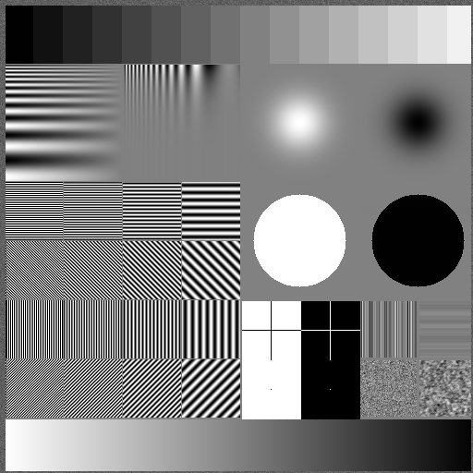
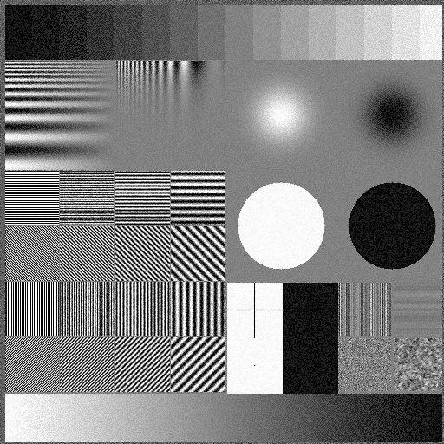
P1. Related Work
From literature review, we observed that existing pixel domain JND algorithms have following two major issues:
The existing algorithms can not include the impact of contrast sensitivity (CS).
Due to this issue, changes made in the signal can be easily perceived by human vision.

Slide 13
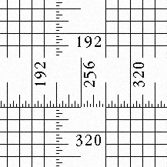
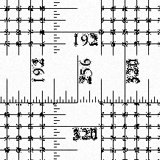
P1. Related Work
2. The existing algorithms may suffer with the under- or over-estimation of the CM.
With this view, in this work our goal is to
Have the first algorithm which includes the impact of CS.
Propose a feed-back mechanism which can alleviate the situation of under- or over-estimation of CM.

Slide 14
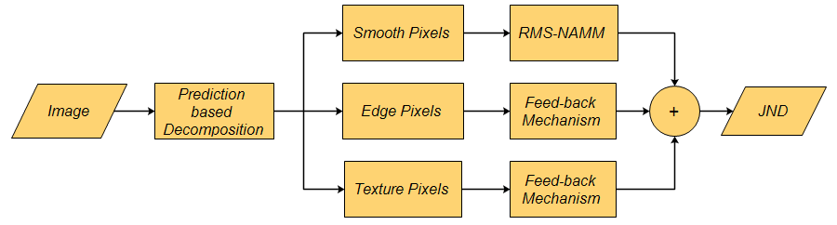
P1. Proposed Algorithm
Our HVS is quite sensitive to the smooth regions and small distortions in these regions can be easily perceived by HVS. With this view, we decompose an image into smooth, edge and texture parts.
To include the contrast sensitivity via RMS-contrast.
Pixel Classification
To alleviate the situation of under- or over- estimation of contrast masking

Slide 15
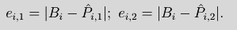
P1. Classification
Any Edge-directed predictor can predict smooth and edge pixels
Bilinear Predictor cannot predict edge and texture regions
OBF [1] predicted image
Bilinear predicted image
Pixel classification based upon the prediction errors of OBF and bilinear predictor.
OBF Based | Bilinear Based | Pixel Classification
Cannot Predict | Cannot Predict | Texture Pixel
Can Predict | Cannot Predict | Edge Pixel
Can Predict | Can Predict | Smooth Pixel
Cannot Predict | Can Predict | Smooth Pixel
[1]. V. Jakhetiya et al., “Fast and efficient intra-frame deinterlacing using observation model based bilateral filter,” in Proc. IEEE International Conference on Acoustics, Speech and Signal Processing (ICASSP), 2014 pp. 5819 - 5823.

Slide 16
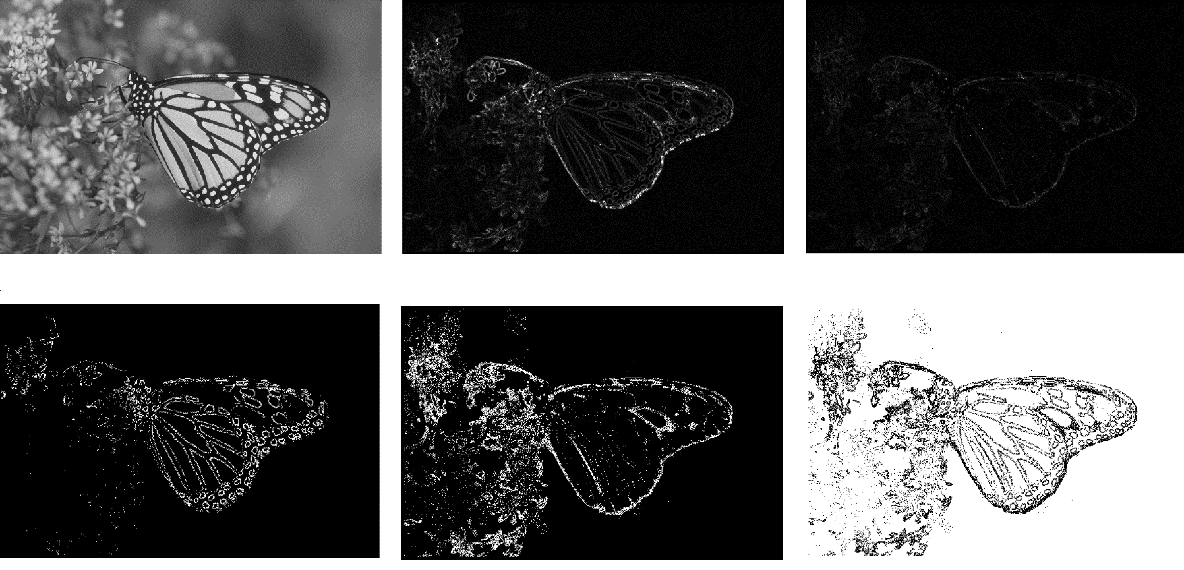
P1. Classification
Original Image
Bilinear Residual Image
Bilateral Residual Image
Edge Classification
Texture Classification
Smooth Classification

Slide 17
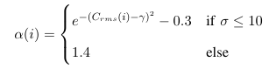
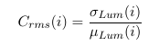
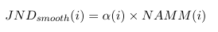
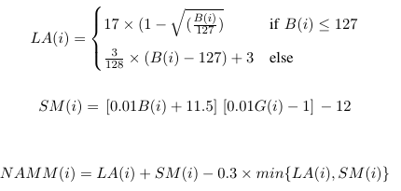
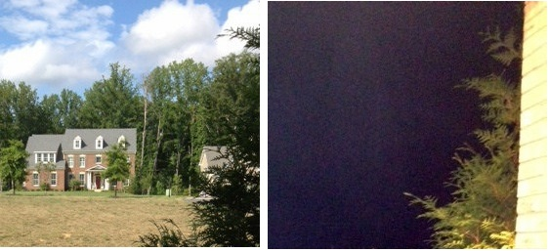
P1. RMS-NAMM (For smooth Pixels)
We modeled the JND estimation in smooth regions by modulating the Non-linear additive masking model (NAMM) [1]:
RMS-Contrast

Slide 18
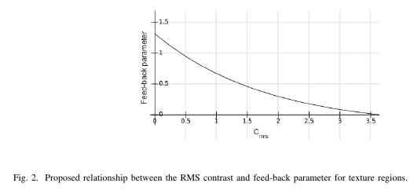
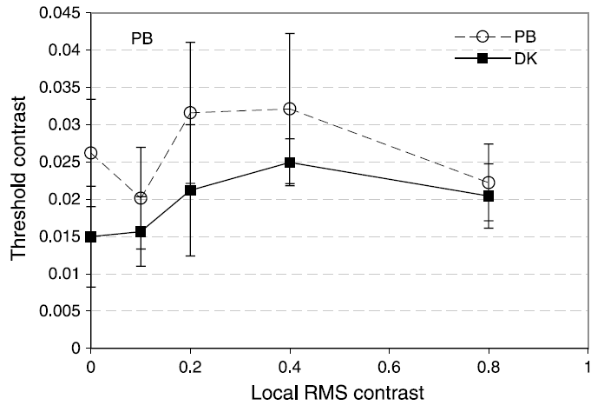
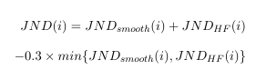
P1. Feed-back Mechanism (for high Frequency Regions)
Proposed relationship between the RMS contrast and feed-back parameter for texture regions.
CM(i)=e_{1,i}
Overall JND model
[1]. D. G. Pelli, and P. Bex, “Measuring contrast sensitivity,” Journal of vision research, pp. 10-14, 2013.

Slide 19
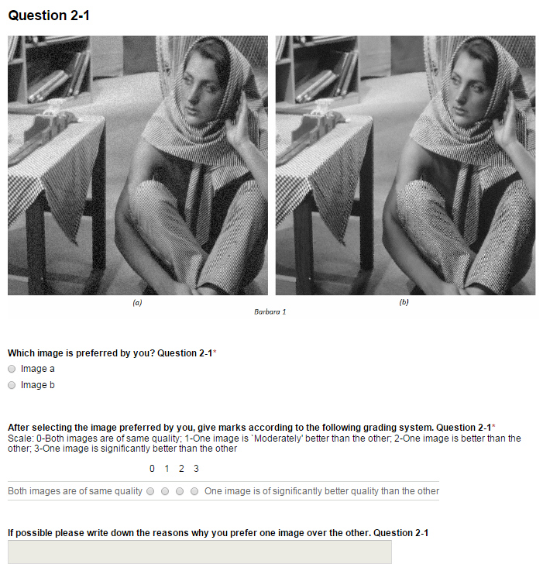
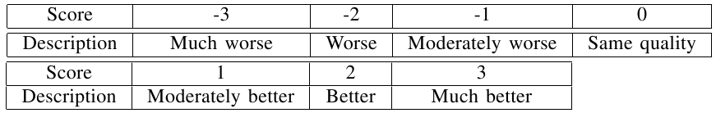
P1. Experimental Results
In order to compare the JND model, noise is shaped into the images and this noise shaping is guided by the corresponding JND, as follows:
We compared proposed algorithm with the existing algorithms according to the Double Stimulus Continuous Quality Scale (DSCQS) type II standard (ITU-R BT.500- 11) [1].
Scoring strategy for the subjective on-line test.
[1]. Assembly, ITU Radio-communication, “Methodology for the subjective assessment of the quality of television pictures”, International Telecommunication Union, 2003
Notes:
DSCQS (Double Stimulus Continuous Quality Scale) type II (ITU-R BT.500-11) standard.

Slide 20
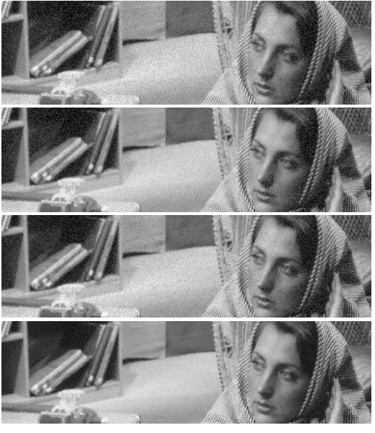
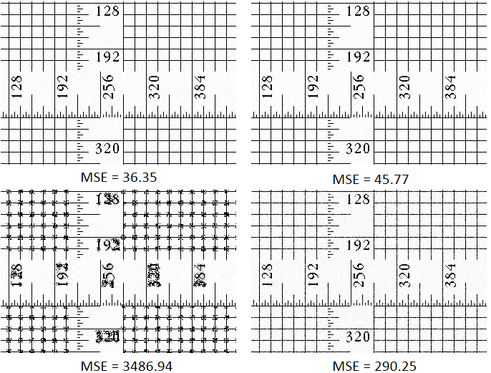
P1. Experimental Results
Over and under estimation of the contrast masking for cropped ‘Ruler’ image.
Comparison of the proposed JND model with state-of-the-art pixel domain JND algorithms. These four rows show four respective noise injected, ‘Barbara’ images (MSE = 152.32), with (a). the NAMM , (b). Liu et al.’s method, (c). Wu et al.’s method and (d). the proposed algorithm.

Slide 21
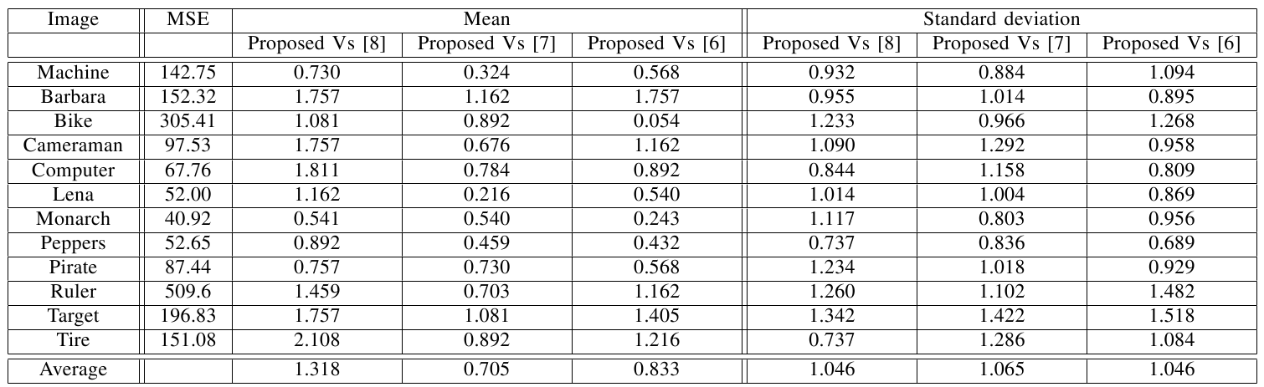
P1. Experimental Results
We asked 37 subjects to give scores to these noise shaped images.
Scoring strategy for the subjective on-line test.
Comparison results of the online subjective test for the noise injected images, guided with the existing and proposed JND models.
[8]. X. K. Yang, et al., “Just noticeable distortion model and its applications in video coding,” Signal Processing: Image Communication, pp. 662-680, 2005.
[7]. A. Liu, et al., “Just noticeable difference for images with decomposition model for separating edge and textured regions,” IEEE Trans. on Circuits and Systems for Video Technology, pp. 1648-1652, 2010.
[6]. J. Wu et al., “Just noticeable difference estimation for images with free-energy principle,” IEEE Trans. on Multimedia, pp. 1705-1710, 2013.

Slide 22
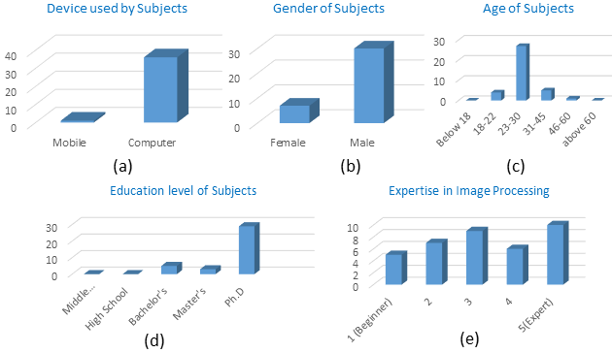
P1. Experimental Results
The dependency of the performance of the proposed algorithm on expertise in image processing of subjects.
1), The subjects with no experience in image processing can perceive that the proposed algorithm has better noise shaping capability with respect to the existing algorithms.
2), Subjects which are experts in the image processing can perceive more difference between the noise shaped images.
Distribution of the device used by subjects (a), gender (b), age (c), education level (d) and expertise in image processing (e) of the 37 subjects.

Slide 23
Outline
Introduction & Motivation
Six Problems Related to Visual Perception
Just-noticeable-difference estimation
No-reference image quality assessment (IQA) for 3D synthesized images using Local descriptor
Perceptually Motivated reconstruction algorithm : A Generic Framework
Reduced-reference IQA for screen content images using distortion categorization
No-reference IQA for natural imaging using distortion prediction and Deep-Learning for KoNiq-10K dataset.
No-reference IQA for 3D synthesized images using outlier prediction.
Conclusion

Slide 24
P4. Perceptually motivated reconstruction algorithm: A generic framework
Related Work
A lot of application specific reconstruction algorithms are proposed in literature.
One application specific algorithms can not be accurately applied to other applications.
In practical scenario’s, we do not have prior information about the cause and level of distortions to the signal.
In this work, our goal is to
Investigate why non-linear and other filters can not perform efficiently for the generic framework.
Propose an algorithm which can be applied to several applications without manually tuning any parameters and having prior information about the cause and level of distortions.
Filling the gap between visual perception and image reconstruction.
V. Jakhetiya, W. Lin, S. P. Jaiswal, S. C. Guntuku and O. C. Au, "Maximum a Posterior and Perceptually Motivated Reconstruction Algorithm: A Generic Framework," IEEE Transactions on Multimedia, vol. 19, pp. 93-106, 2017.

Slide 25
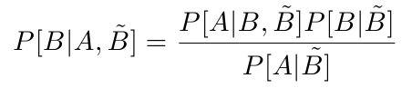
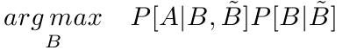
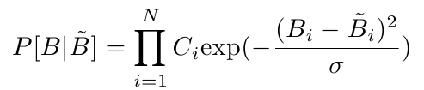
P4. Perceptually motivated reconstruction algorithm: A generic framework
In this work, we propose to formulate reconstruction problem as a Maximum-a-posterior (MAP) problem:
Input Image
Restored Image in first pass
Restored Image
Likelihood term
Prior term
The prior term can be modelled as the Gaussian distribution [1].
[1]. J. Wang, G. Jeon and J. Jeong, “Deinterlacing algorithm using weighted least squares,” IEEE Trans. on circuit and systems for video technology, pp. 39-48, 2014.

Slide 26
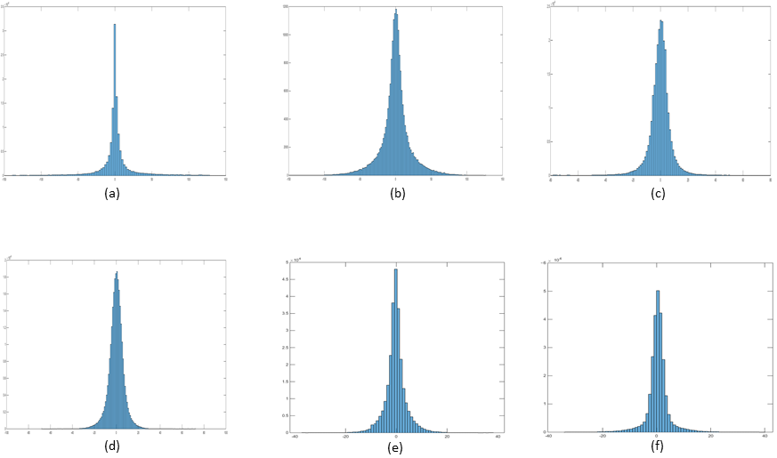
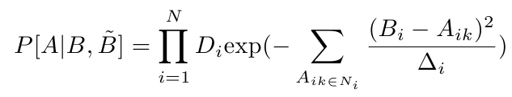
P4. Perceptually motivated reconstruction algorithm: A generic framework
Similarly, likelihood term also follows the Gaussian distribution.
Figure. 4.1 Distribution of the residual errors of original image and reconstructed image in the first stage for six applications, such as (a), de-interlacing, (b), interpolation, (c), prediction of missing pixels of randomly sampled image, (d), Gaussian noise, and (e), JPEG and (f), J2k compression, respectively.

Slide 27
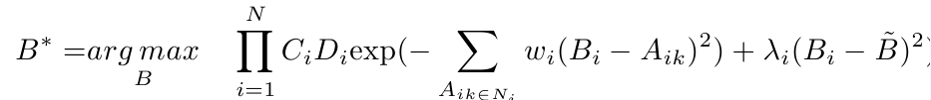
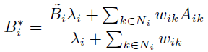
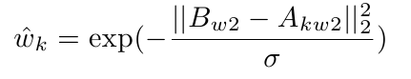
P4. Perceptually motivated reconstruction algorithm: A generic framework
Finally the solution of MAP estimator can be obtained as:
Contribution of Prior
Variance of MAP
In literature the variance of MAP is approximated using the MSE based non-linear filters such as, Bilateral filter and NLM filter.

Slide 28
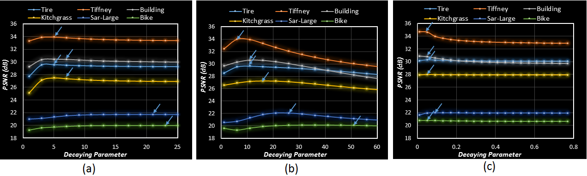
P4. Perceptually motivated reconstruction algorithm: A generic framework
Unfortunately, two main issues are associated with these filters.
The performance of these non-linear filters highly depends upon the level of distortion to the signal.
Figure. 4.2 Dependency of reconstruction accuracy (in terms of PSNR) of (a) bilateral filter, and (b) NLM filter, with a decaying parameter for predicting the missing pixels of the interlaced image. Here, blue arrows represent the best performance.

Slide 29
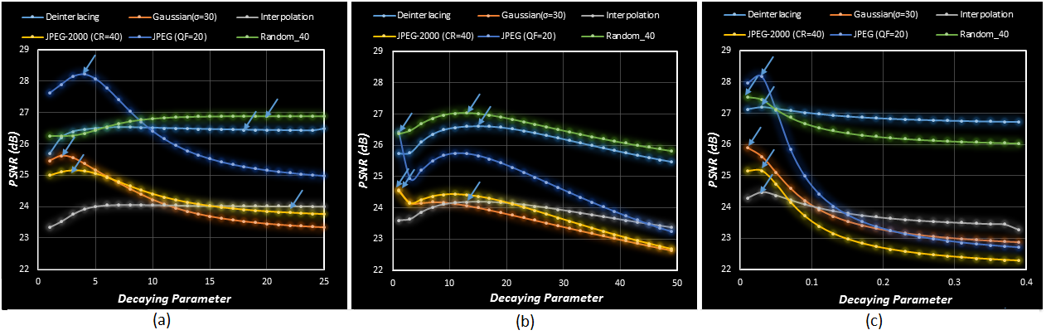
P4. Perceptually motivated reconstruction algorithm: A generic framework
Success of these non-linear filters lies in the successfully anticipating the cause of distortions to the signal and accordingly, adapting the decaying parameters. It is difficult to anticipate the cause of distortion to the signal, in the practical scenarios.
Figure. 3.3 Dependency of average reconstruction accuracy (in terms of PSNR) of (a) bilateral filter, and (b) NLM filter, with decaying parameter for several image processing applications. Here, blue arrows represent the best performance. In order to show the average reconstruction accuracy for each of these applications, we calculated the PSNR for six images corresponding to the decaying parameter and averaged the PSNR.

Slide 30
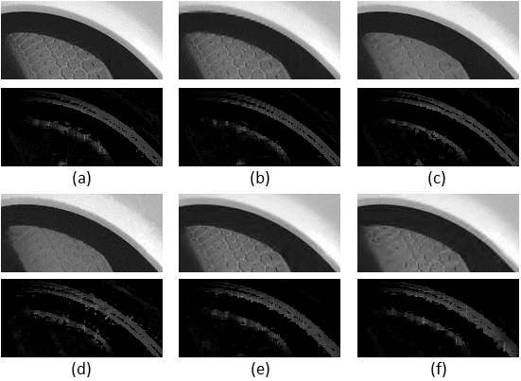
P4. Perceptually motivated reconstruction algorithm: A generic framework
Interestingly, recent research by the image quality assessment research community [1], [2] have suggested that the gradient magnitude of original signal and distorted signal does not change significantly with the addition of distortions.
In this work, we propose to utilize this property to find similar pixels in the neighborhood in the noisy and unreliable conditions.
Figure. 4.4 Dependency of the GMSD with different types and level of distortions such as, (b) de-interlacing, (c) and (d) Gaussian noise with σ = 10 and 20, respectively, (e) and (f) J2k compression with compression ratio = 10 and 20, respectively, for ‘Tire’ image (a). In each figure, the first row is the distorted image and the second row shows the inverse of GMSD values between the pixel of interest and its neighboring pixel (in the diagonal direction).
[1]. W. Xue, L. Zhang, X. Mou and A. C. Bovik, “Gradient magnitude similarity deviation: A highly efficient perceptual image quality index,”
IEEE Trans. on Image Processing, pp. 684-695, 2014.
[2]. A. Liu et al., “Image quality assessment based on gradient similarity,” IEEE Trans. Image Processing, pp. 1500-1512, 2012.

Slide 31
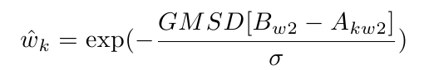
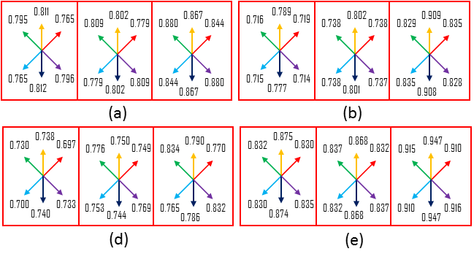
P4. Perceptually motivated reconstruction algorithm: A generic framework
With this view, we have incorporated the gradient magnitude similarity based GMSD [1] metric with the image reconstruction.
We proposed to approximate the variance of MAP as:
Figure. 4.5 Comparison of the ability of the bilateral filter, non-local means filter and the proposed algorithm for approximating the variance of the MAP estimation.
[1]. W. Xue, L. Zhang, X. Mou and A. C. Bovik, “Gradient magnitude similarity deviation: A highly efficient perceptual image quality index,”
IEEE Trans. on Image Processing, pp. 684-695, 2014.

Slide 32
P4. Perceptually motivated reconstruction algorithm: A generic framework
With the inclusion of gradient similarity based GMSD metric, our proposed algorithm can solve two major issues associated with the reconstruction algorithms.
The proposed algorithm does not need to manually tune any parameters to suite the level of degradation and cause of the distortions.
Figure. 4.6 Dependency of the proposed algorithm on the level and cause of the distortions.

Slide 33
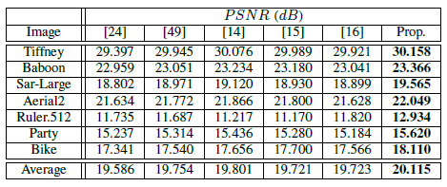
P4. Experimental Results (Interpolation)
Table 4.1. Comparison of restoration results for image interpolation. The best performance is highlighted with boldface.
[24]. R. Keys, “Cubic convolution interpolation for digital image processing,” IEEE Trans. on Acoustics, Speech and Signal Processing, pp. 1153-1160, 1981.
[49]. D. Zhou, X. Shen and W. Dong, “Image zooming using directional cubic convolution interpolation,” IET Image Processing, pp. 627-635, 2012.
[14]. X. Zhang and X. Wu, “Image interpolation by adaptive 2-D autoregressive modeling and soft-decision estimation,” IEEE Trans. on Image Processing, pp. 887-896, 2008.
[15]. S. Mallat and G. Yu, “Super-resolution with sparse mixing estimators,” IEEE Trans. on Image Processing, pp. 2889-2900, 2010.
[16]. Z. Wei and K. K. Ma, “Contrast-guided image interpolation,” IEEE Trans. on Image Processing, pp. 4271-4285, 2013.

Slide 34
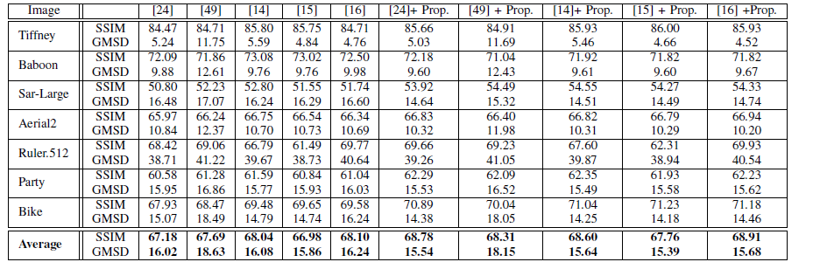
P4. Experimental Results (Interpolation)
Table 4.2. Simulation results comparison in terms of SSIM (in %) and GMSD (in %) for interpolation and dependency of the proposed Algorithm on reconstruction algorithm used in the first pass. The best performance is highlighted with boldface.
[24]. R. Keys, “Cubic convolution interpolation for digital image processing,” IEEE Trans. on Acoustics, Speech and Signal Processing, pp. 1153-1160, 1981.
[49]. D. Zhou, X. Shen and W. Dong, “Image zooming using directional cubic convolution interpolation,” IET Image Processing, pp. 627-635, 2012.
[14]. X. Zhang and X. Wu, “Image interpolation by adaptive 2-D autoregressive modeling and soft-decision estimation,” IEEE Trans. on Image Processing, pp. 887-896, 2008.
[15]. S. Mallat and G. Yu, “Super-resolution with sparse mixing estimators,” IEEE Trans. on Image Processing, pp. 2889-2900, 2010.
[16]. Z. Wei and K. K. Ma, “Contrast-guided image interpolation,” IEEE Trans. on Image Processing, pp. 4271-4285, 2013.

Slide 35
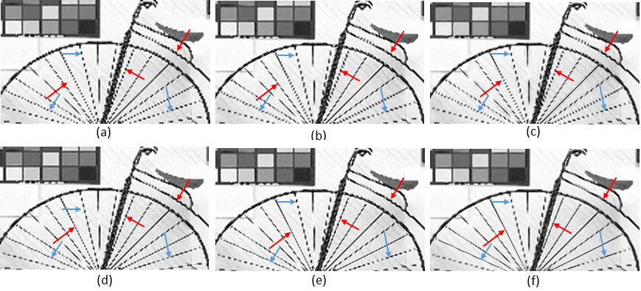
P4. Experimental Results (Interpolation)
Figure. 4.7 Comparison of subjective quality for interpolated ‘Bike’ image with a factor of 2 with, (a) Bicubic [24] (17.335 dB), (b) directional Bicubic [49] (17.541 dB), (c) SAI [14] (17.656 dB), (d) SME [15] (17.700 dB), (e) contrast guided [16] (17.566 dB) and (f) proposed algorithm (18.110 dB), respectively.
[24]. R. Keys, “Cubic convolution interpolation for digital image processing,” IEEE Trans. on Acoustics, Speech and Signal Processing, pp. 1153-1160, 1981.
[49]. D. Zhou, X. Shen and W. Dong, “Image zooming using directional cubic convolution interpolation,” IET Image Processing, pp. 627-635, 2012.
[14]. X. Zhang and X. Wu, “Image interpolation by adaptive 2-D autoregressive modeling and soft-decision estimation,” IEEE Trans. on Image Processing, pp. 887-896, 2008.
[15]. S. Mallat and G. Yu, “Super-resolution with sparse mixing estimators,” IEEE Trans. on Image Processing, pp. 2889-2900, 2010.
[16]. Z. Wei and K. K. Ma, “Contrast-guided image interpolation,” IEEE Trans. on Image Processing, pp. 4271-4285, 2013.

Slide 36
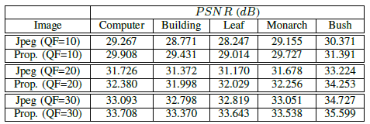
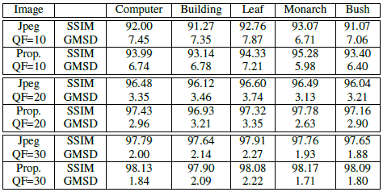
P4. Experimental Results (Removing Compression artifacts for JPEG compression)
Table 4.3. Comparison of restoration results in terms of PSNR (dB), SSIM (in %) and GMSD (in %) for jpeg decoded images. here “QF” refers to the quality factor.

Slide 37
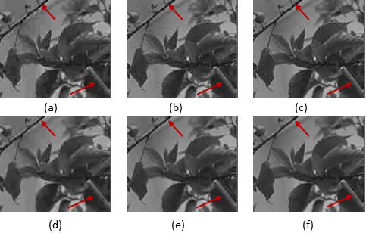
P4. Experimental Results (Removing Compression artifacts for JPEG compression)
Figure 3.8 Comparison of subjective quality for reconstructed ‘Building’ image, (a) Jpeg (quality factor (QF) = 10, 28.771 dB), (b) Jpeg (QF = 20, 31.372 dB) (c) Jpeg (QF = 30, 32.798 dB), (d) proposed algorithm (QF = 10, 29.431 dB), (e) proposed algorithm (QF = 20, 31.998 dB), and (f) proposed algorithm (QF = 30, 33.370 dB).

Slide 38
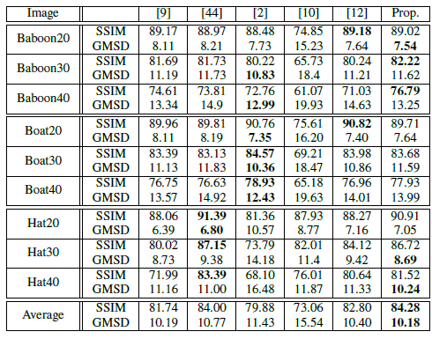
P4. Experimental Results (Removing Gaussian Noise)
Table 3.4. Comparison of restoration results in terms of SSIM (in %) and GMSD (in %) for image added with Gaussian noise. Here ‘Baboon20’ represents the ‘baboon’ image contaminated with Gaussian noise with noise level σ= 20. The best performance is Highlighted with boldface.
[9]. A. Buades, B. Coll, and J. M. Morel, “A non-local algorithm for image denoising,” in Proc. of Computer Vision and Pattern Recognition, 2005
(CVPR), pp. 60-65, 2005.
[44]. K. Dabov et al, “Image denoising by sparse 3-D transform-domain collaborative filtering,” IEEE Trans. Image Processing, pp. 2080-2095, 2007.
[2]. H. Takeda, S. Farsiu, and P. Milanfar, “Kernel regression for image processing and reconstruction,” IEEE Trans. on Image Processing, pp. 349-366, 2007.
[10]. K. N. Chaudhury and A. Singer, “Non-Local Euclidean Medians,” IEEE Signal Proc. Letters, pp. 745-478, 2012.
[12]. H. Talebi, X. Zhu and P. Milanfar, “How to SAIF-ly boost denoising performance,” IEEE Trans. on Image Processing, pp. 1470-1485, 2013.

Slide 39
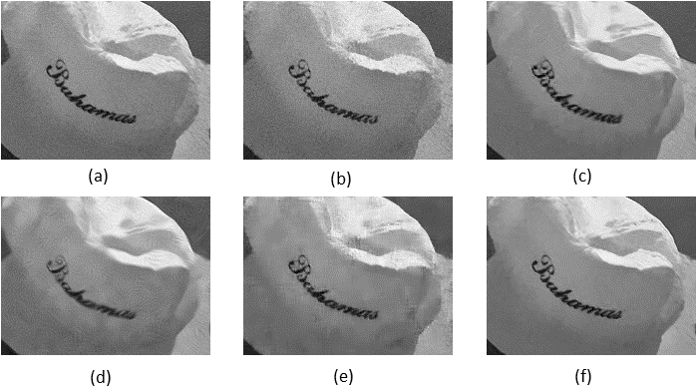
P4. Experimental Results (Removing Gaussian Noise)
Figure 3.9. Comparison of subjective quality for reconstructed ‘Hat’ image contaminated with Gaussian noise with noise level σ = 30. A Gaussian noise contaminated image, restored with (a) NLM filter [9] (29.166 dB), (b) Kernel regression [2] (28.773 dB), (c) BM3D [44] (30.440 dB), (d) NLEM filter [10] (28.943 dB), (e) SAIF [12] (29.703 dB), and (f) the proposed algorithm (30.093 dB).
[9]. A. Buades, B. Coll, and J. M. Morel, “A non-local algorithm for image denoising,” in Proc. of Computer Vision and Pattern Recognition, 2005
(CVPR), pp. 60-65, 2005.
[44]. K. Dabov et al, “Image denoising by sparse 3-D transform-domain collaborative filtering,” IEEE Trans. Image Processing, pp. 2080-2095, 2007.
[2]. H. Takeda, S. Farsiu, and P. Milanfar, “Kernel regression for image processing and reconstruction,” IEEE Trans. on Image Processing, pp. 349-366, 2007.
[10]. K. N. Chaudhury and A. Singer, “Non-Local Euclidean Medians,” IEEE Signal Proc. Letters, pp. 745-478, 2012.
[12]. H. Talebi, X. Zhu and P. Milanfar, “How to SAIF-ly boost denoising performance,” IEEE Trans. on Image Processing, pp. 1470-1485, 2013.

Slide 40
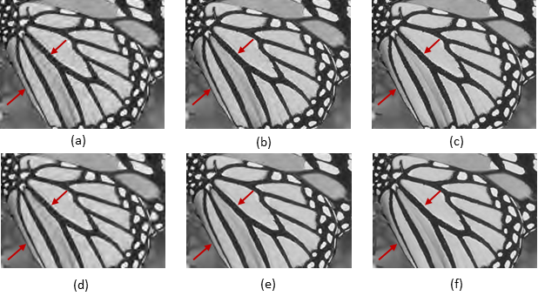
P4. Experimental Results (Removing Compression artifacts for JPEG-2000 compression)
Figure 3.10 Comparison of subjective quality for reconstructed ‘Monarch’ image, (a) Jpeg-2000 (compression ratio (CR) = 80, 27.718 dB), (b) Jpeg-2000 (CR =40, 31.212 dB), (c) Jpeg-2000 (CR = 26.7, 33.801 dB), (d) proposed algorithm (CR = 80, 27.916 dB), (e) proposed algorithm (CR = 40, 31.485 dB), and (f) proposed algorithm (CR = 26.7, 34.026 dB).
V. Jakhetiya, W. Lin, S. P. Jaiswal, S. C. Guntuku and O. C. Au, "Maximum a Posterior and PerceptuallyMotivated Reconstruction
Algorithm: A Generic Framework," IEEE Transactions on Multimedia, vol. 19, pp. 93-106, 2017.

Slide 41
Outline
Introduction & Motivation
Six Problems Related to Visual Perception
Just-noticeable-difference estimation
Perceptually Motivated reconstruction algorithm : A Generic Framework
No-reference image quality assessment (IQA) for 3D synthesized images using Local descriptor
Reduced-reference IQA for screen content images using distortion categorization
No-reference IQA for natural imaging using distortion prediction and Deep-Learning for KoNiq-10K dataset.
No-reference IQA for 3D synthesized images using outlier prediction.
Conclusion

Slide 42
P2. Image Quality Assessment (IQA)
Two approaches
Subjective evaluation
Most Reliable
Time-consuming, laborious, viewer-dependent, impractical in real-world scenarios.
Objective evaluation
Full-Reference (FR)- requires complete information about the reference image
Reduced-Reference (RR)- requires some information about the reference image
No-Reference (NR)- no other information is requires.
These IQA metrics are useful in following scenarios, such as
Matches with human vision and eliminate the need of subjective testing.
Quality monitoring and enhancing quality of experience (QoE).
Achieve better image/video reconstruction accuracy.

Slide 43

P4. No-Reference IQA for 3D synthesized images
Free view-point videos and 3D television received a lot of attentions due to its widespread applications in remote education, entertainment, medical applications and remote surveillance.
Require to generate new views with the help of neighboring multiple views.

Slide 44




P4. No-Reference IQA for 3D synthesized images
Related Work
IQA Research community have achieved a great progress for natural images and a lot of efficient IQA algorithms are proposed in the literature [1].
Natural images are generally distorted with the structural distortions.
Gaussian Noise
Gaussian Blur
Jpeg-Compression
Jpeg-2000 Compression
In this work, our goal is to
Investigate why IQA metrics designed for natural images can not judge the quality of 3D synthesized images
Propose an algorithm to identify distortions in 3D synthesized images and judge its quality.
[1]. Z. Wang et al., “Image quality assessment: from error visibility to structural similarity,” IEEE Trans. on Image Processing, 2004.

Slide 45


P4. No-Reference IQA for 3D synthesized images
The 3D synthesized images are distorted due to the geometrical distortions and these distortions have different characteristics than the structural distortions occurring in the natural images.
A few FR-IQA metrics are proposed for the 3D synthesized images but performance of these algorithms is still not satisfactory.
Secondly, no NR-IQA algorithm for 3D synthesized images has been proposed yet and in practical scenarios reference images are not available. So, NR-IQA algorithm is highly preferred for 3D synthesized images.
Reference Image
Distorted Image due to the geometrical distortions

Slide 46







P4. Issues with the existing IQA algorithms for 3D synthesized images
The existing IQA algorithms designed for natural images are not able to catch geometrical distortions and perform poorly for 3D synthesized images.
MOS=1.0
MOS=2.7
MOS=3.2
MOS=3.9
MOS=4.2
[1]. A Mittal et al., “No-reference image quality assessment in the spatial domain,” IEEE Trans. Image Process., vol. 21, no. 12, Dec. 2012.
[2]. K. Gu et al., “Using free energy principle for blind image quality assessment,” IEEE Trans. on Multimedia, pp. 2015.
Notes:
Mean Subtracted Contrast Normalized (MSCN) i-m/\sigma

Slide 47




P4. Proposed Algorithm for 3D Synthesized Images
Quality perception by the human visual system. The left image is one typical DIBR-synthesized image under strong geometry distortion corruption. Via the human visual system (middle), the left DIBR-synthesized image can be classified into geometry distortion and non-geometry distortion regions, as illustrated in the right image.
With this view, we have used AR-modelling to estimate the residual errors:
Ordinary least squares

Slide 48





P4. Proposed Algorithm for 3D Synthesized Images
(a)
Histogram of Patch with geometrical distortions
Histogram of
Smooth patch
Histogram of
Texture patch
Histogram of
Edge patch

Slide 49



P4. Proposed Algorithm for 3D Synthesized Images
The free-energy principle can effortlessly highlight the geometrical distortions. We binarize the error maps as:
The final quality score is calculated using the distance between the error map of distorted and reference image [1], as:
Here M_{r} is a binary map of the reference image, in which we can assume that all the values in it are unit. Quality score is simplified as:
The binary map of the distorted image can be divided into regions with geometric distortions and without geometric distortions as:
[1]. Z. Wang et al., “Image quality assessment: from error visibility to structural similarity,” IEEE Trans. on Image Processing, 2004.

Slide 50


P4. Proposed Algorithm for 3D Synthesized Images
All the values in L₀ region are zero, as error values are greater than the threshold ϒ_{t}. So , finally, quality score is obtained as:
The quality score can be readily solved as the ratio of number of pixels in the non-geometry distorted regions and the total number of pixels in the 3D synthesized image.
Proposed algorithm does not require to have any information about the reference image, so our proposed algorithm is completely blind/reference-less.
The 3D synthesized images have a higher quality when score is close to one.

Slide 51

P4. Experimental Results
Performance comparison of the proposed algorithm with recently developed metrics.
FR for Natural Images
RR for Natural Images
The proposed algorithm is able to achieve best performance till today for 3D synthesized images and moreover, proposed algorithm is no-reference in nature..
NR for Natural Images
FR for 3D Synthesized Images

Slide 52



P4. Experimental Results
Performance of improved FR IQA models for DIBR-synthesized views by combining our blind APT metric.
Performance dependency of the proposed APT metric with the changing
thresholds (ϒ_{t}).
[25]. D. S. Stankovic, et al., “DIBR-synthesized image quality assessment based on morphological wavelets," in Proc. IEEE Int. Workshop on Quality of Multimedia Experience, Jan. 2015.
[26]. D. S. Stankovic, et al., “DIBR-synthesized image quality assessment based on morphological pyramids,” The True Vision-Capture, Transmission and Display of 3D Video, Oct. 2015.

Slide 53
Outline
Introduction & Motivation
Six Problems Related to Visual Perception
Just-noticeable-difference estimation
No-reference image quality assessment (IQA) for 3D synthesized images using Local descriptor
Reduced-reference IQA for screen content images using distortion categorization
No-reference IQA for natural imaging using distortion prediction and Deep-Learning for KoNiq-10K dataset.
No-reference IQA for 3D synthesized images using outlier prediction.
Perceptually Motivated reconstruction algorithm : A Generic Framework
Conclusion

Slide 54


P3. Reduced-Reference IQA for Screen Content (SC) Images
The SC images have wide-spread usage in online education, online gaming, virtual screen sharing, etc.
The SC images contains both pictorial and textual parts and have different characteristics than the natural images.
For example, sharpness in SC images is much higher than of the natural images [1].
Natural Images
Text Images
Screen Content Images
Distribution of values in the naturalness maps of the example images.
[1]. H. Yang, Y. Fang, and W. Lin, “Perceptual quality assessment of screen content images,” IEEE Trans. on Image Processing, pp. 4408-4421, 2015.

Slide 55



P3. Issues with the Existing IQA algorithms for Screen Content Image
Existing free-energy principle based IQA algorithms
Predicted Part
Disorder Residual Part
Perceptually Important
Perceptually Unimportant

Slide 56










P3. Issues with the Existing IQA algorithms for Screen Content Image
Original Image
Distorted Image
Predicted Part
Disorder Residual Part
Predicted Part
Disorder Residual Part
FEP based IQA algorithms separate most of the information of SC images into disorder residual part.
Assume these regions are not important for human vision.
[1]. J. Wu, W. Lin, G. Shi and A. Liu, “Perceptual quality metric with internal generative mechanism,” IEEE Trans. on Image Processing, pp. 43-54, 2013.
[2]. G. Zhai, X. Wu, X. Yang, W. Lin and W. Zhang, “A psychovisual quality metric in free-energy principle,” IEEE Trans. on Image Processing, pp. 41-52, 2012.

Slide 57

P3. Issues with the Existing IQA algorithms for Screen Content Image
In contrast to these assumptions, human vision selects textual regions as the salient part.
Subjective evaluation suggests that the textual part of a SC image contributes more to the over-all quality than the pictorial part.
Original Image
Gaussian Noise
Gaussian Blur
Jpeg Compression
[1]. H. Yang, Y. Fang, and W. Lin, “Perceptual quality assessment of screen content images,” IEEE Trans. on Image Processing, pp. 4408-4421, 2015.

Slide 58


P3. Proposed RR IQA algorithm for SC images
With this view, it is required to use more perceptually relevant local prediction model, which can separate most of the information of textual region in to the predicted part.
Original Pixel
Weights
Neighboring pixels
Predicted Pixel

Slide 59


P3. Proposed RR IQA algorithm for SC images
The strength of the edge structures (sharpness) can extract primary visual information.
The final quality score is estimated as:

Slide 60

P3. Experimental Results
Comparison of the proposed algorithm with six FR (PSNR, SSIM, IGM, GSIM, GMSD and VSI) and four RR algorithms (OSVP, FEDM, RRED and RRVIF) in terms of PLCC, SRCC and RMSE for the SIQAD database. The last column represents the running time (in seconds) of corresponding algorithm to predict the quality of a SC image. Here N is the number of pixels in the SC image.

Slide 61

P3. Experimental Results
Comparison of the statistical significance of the proposed algorithm and 10 IQA algorithms on the SIQAD database.
The proposed and SSIM and GMSD IQA metrics are statistically comparable.
The prevailing distortions in the SC images are due to the JPEG and J2K compression.
Comparison of the proposed algorithm with five RR Algorithms for JPEG and J2K images (280 images) in SIQAD Database.

Slide 62
Konstanz Natural Image Quality-10k Dataset (KoNIQ-10K)
In existing IQA databases such as SIQAD, Live, Live-in-the-wild, TID, CSIQ
are very small in size (less than 1000 images) and
they only give the information about the perceptual quality.
With this view, we created a new dataset namely KoNIQ-10K dataset,
It has 10,373 images of different categories.
Each image is at-least judged by 65 subjects via outsourcing using crowdflower.com.
To create this dataset approximately 1 million subjective testing are performed.
Each subject is asked to give quality score and also identify the perceivable distortions.
These four distortions are:
Blur distortion: due to the incorrect focus, camera shake, or motion blur.
Contrast distortion: caused by excessive contrast adjustments or over-sharpening or simply bad exposure.
Artifacts: due to compression artifacts, grain or noise due to high ISO settings, pixelation or aliasing due to poor image upscaling, etc.
Color distortion: because of color shifting (fringing) and over-saturation.
No distortion: if a subject is not able to identify any distortion.
** We are thankful to Prof. Dietmar Saupe from University of Konstanz, Germany for sponsoring this research work

Slide 63


Which Distortion Most Affects the Perceptual Quality of Natural Images?
Fig.1: Relationship between the combinations of distortions and the prediction of perceptual quality.
The blur most affects the perceptual quality (weight corresponding to the blur is highest in each
fig 1.(a), 1.(b), and 1.(d) followed by the artifacts).
Without the prediction of blur distortion, other distortions do not have the ability of accurately
predicting the perceptual quality (Fig. 1(c)).
The efficient estimation of perceptual blur and artifacts can help to estimate the quality
of images with a correlation coefficient higher than 0.92 (as shown in Fig 1(a) and 1(b)).

Slide 64

DAIQA: Distortion-aware and Deep-Learning based Image Quality Assessment in the Wild
Practical Information
Pre-trained Network: ResNet-101
Learning Rate: 0.01
Activation Function: ReLU
Loss Function: MSE
No. of Layers Freezed: 85

Slide 65
DAIQA: Distortion-aware and Deep-Learning based Image Quality Assessment in the Wild
Table I. Comparison of state-of-the-art deep-learning based IQA methods with the proposed method
Table 2. Capability of the proposed method in predicting the perceptual distortion levels.
Method | PLCC | SROCC
BIQI | 0.62 | 0.61
BLIINDS-II | 0.58 | 0.55
BRISQUE | 0.70 | 0.71
BosICIP [1] | 0.67 | 0.65
CNN [2] | 0.67 | 0.63
DeepBIQA [3] | 0.87 | 0.85
Proposed DAIQA | 0.92 | 0.91
Distortion | PLCC | SROCC
Artifact | 0.97 | 0.96
Blur | 0.96 | 0.96
Contrast | 0.97 | 0.95
Color | 0.95 | 0.93
No-Distortion | 0.97 | 0.95
[1]. Sebastian Bosse, Dominique Maniry, Thomas Wiegand, and Wojciech Samek, “A deep neural network for image quality assessment,” in IEEE International Conference on Image Processing. IEEE, 2016, pp. 3773–3777.
[2]. Le Kang, Peng Ye, Yi Li, and David Doermann, “Convolutional neural networks for no-reference image quality assessment,” in IEEE Conference on Computer Vision and Pattern Recognition, 2014, pp. 1733–1740.
[3]. K. Ma, W. Liu, K. Zhang, Z. Duanmu, Z. Wang and W. Zuo, "End-to-End Blind Image Quality Assessment Using Deep Neural Networks,” in IEEE Transactions on Image Processing, vol. 27, no. 3, pp. 1202-1213, March 2018.

Slide 66

DAIQA: Distortion-aware and Deep-Learning based Image Quality Assessment in the Wild
The first row corresponds to the original images from the KonIQ-10k dataset.
Their marked rectangle parts are enlarged in the second row.
Their corresponding predicted distortion levels are shown in third row, where the five bars correspond to artifacts, blur, contrast, colors, and no distortion, respectively.

Slide 67







A1. Multi-Level inference quality scheme using joint offloading and prefetching
Low resolution
(2-8 bits integer) and complexity model
Crowd distribution
and location prediction
& Making Decision
Medium resolution
(16 bit float) and complexity models
Highest/Medium resolution
(64/32 bits) and
complexity models
Offloading and fetching
prefetch
DL App
Object
Cache
Model
Cache
Center
Services
Model & Object
Storage
User Equipment
MEC Server
LTE based Station
Core / IT
1. Low accuracy result
2. Higher accuracy result
3. Highest accuracy result
Vinit Jakhetiya, Wang Lu, Richard Yu, "Method and System for Jointly Determining Computational Offloading and Content Prefetching in a Cellular Communication System, filed a USA Patent, Patent Number 15/615,988.
Notes:
Add discription

Slide 68


A1. Multi-Level inference quality scheme using joint offloading and prefetching
Virtual Reality (VR) rendering control by Oriented FAST and rotated BRIEF based Simultaneous Localization and Mapping (ORB-SLAM) for camera motion tracking:
HMD + MEC
HMD Only
 | Delay | Power consumption | Frame rate (VGA)
HMD + MEC | Low network delay (less than 200ms) | Low | 30 fps
HMD Only | High compute delay (500ms) | High | 2 fps
All these mobile applications can benefit from our algorithm:
Mobile medical image/video analytics system
Mobile object recognition and tracking for autopilot and navigation
Intelligent surveillance system

Slide 69
Conclusions
We have studied the properties of human vision and characteristics of the visual signals.
These characteristics are applied for the visual perception based:
Just-noticeable-difference estimation
First pixel JND algorithm which includes Contrast Sensitivity.
No-reference image quality assessment for 3D synthesized images
First no-reference IQA algorithm and it achieves best performance till today.
Reduced-reference image quality assessment for screen content images
First RR IQA algorithm and achieves better performance then existing RR IQA algorithms.
Perceptually motivated reconstruction algorithm: A generic framework.
Filling the gap between visual perception and image reconstruction, it can be applied to several image processing application.
Deep-Learning based image quality assessment for KoNiq-10K dataset
Created the largest dataset for IQA. Predicting both quality score and the quality degrading distortions.
No-reference image quality assessment for 3D synthesized images
Understanding the behavior of pixels in the geometric distortion regions.

Slide 70
Future Work
Create an unified IQA and JND estimation algorithm which can handle images with diverse characteristics such as
Natural,
Screen content,
3D synthesized,
Graphical and,
Retargeted images.
Develop a mobile application using Deep-Learning which can:
Automatic estimation of quality of captured images
Identify cause of the quality degradation
Predict the distortion levels
Finally automatic removal of the distortions using Deep-Learning.
Create new database for 3D-synthesized images and introduce machine learning algorithms for IQA of these images.

Slide 71
Publications (I)
Journal Publications
V. Jakhetiya, K. Gu, W. Lin, Q. Li and S. P. Jaiswal, "A Prediction Backed Model for Quality Assessment of Screen Content and 3-D Synthesized Images," IEEE Transactions on Industrial Informatics, vol. 14, no. 2, pp. 652-660, 2018 (I.F=6.762).
V. Jakhetiya, W. Lin, S. Jaiswal, K. Gu, S. C. Guntuku, Just Noticeable Difference for natural images using RMS contrast and feed-back mechanism, Elsevier Neurocomputing, Vol. 275, Pages 366-376, 2018 (I.F = 3.317).
K. Gu, V. Jakhetiya, J. F. Qiao, X. Li, W. Lin and D. Thalmann, "Model-Based Referenceless Quality Metric of 3D Synthesized Images Using Local Image Description," IEEE Transactions on Image Processing, vol. 27, pp. 394-405, 2018 (I.F = 4.828).
V. Jakhetiya, W. Lin, S. P. Jaiswal, S. C. Guntuku and O. C. Au, "Maximum a Posterior and Perceptually Motivated Reconstruction Algorithm: A Generic Framework," IEEE Transactions on Multimedia, vol. 19, pp. 93-106, 2017 (I.F = 3.509).
S. P. Jaiswal, L. Fang, V. Jakhetiya, K. Mueller and O. C. Au, "Adaptive Multispectral Demosaicking Based on Frequency-Domain Analysis of Spectral Correlation," IEEE Transactions on Image Processing, vol. 26, pp. 953-968, 2017 (I.F = 4.828).

Slide 72
Publications (II)
6. J. Qian, L. Tang, V. Jakhetiya, Z. Xia, K. Gu and H. Lu, "Towards efficient blind quality evaluation of screen content images based on edge-preserving filter," IET / IEEE Electronics Letters, vol. 53, no. 9, pp. 592-594, 2017 (I.F = 1.061).
7. S. I. Niwas, V. Jakhetiya, W. Lin, C. K. Kwoh, C. C. Sng, Complex wavelet based quality assessment for AS-OCT images with application to Angle Closure Glaucoma diagnosis, Elsevier Computer Methods and Programs in Biomedicine, Vol. 130, Pages 13-21, 2016 (I.F = 2.509).
Journal Publications (Submitted/in Preparation)
Vinit Jakhetiya, Ke Gu, Trisha Singhal, Sharath C. Guntuku “A Highly Efficient and Fast Image Quality Assessment Metric for 3D Synthesized Images ,” submitted to IEEE Trans. on Industrial Informatics.
Vinit Jakhetiya, Dietmar Saupe, Sharath C. Guntuku, Vlad Hose “Distortion Prediction and Deep-Learning based Blind Image Quality Assessment for Konvid-10K Dataset ,” will be submitted to IEEE Trans. on Image Processing.
Sunil Jaiswal, Vinit Jakhetiya, klaus Mueller, “Optimized Frequency-Split-Based Low-Dose CT Reconstruction,” submitted to IEEE Trans. on Medical Imaging (in second round).

Slide 73
Publications (III)
Publications in Tier-1 Conferences
V. Jakhetiya, S. Jaiswal, A. k. Tiwari, "A computationally efficient context based switched image interpolation algorithm for natural images", 28th IEEE International Instrumentation and Measurement Technology Conference (IEEE I2MTC) 2011, China, 10-12 May (Won Undergraduate Student Best Paper Award).
V. Jakhetiya, S. Jaiswal, A. k. Tiwari, O. C. Au, “Interpolation Based Symmetrical Predictor Structure For Lossless Image Coding,” IEEE International Symposium on Circuits and Systems (IEEE ISCAS), 20-23 May 2012, Seoul, Korea.
S. Jaiswal, O. C. Au, V. Jakhetiya, A. K. Tiwari, “Efficient Adaptive Prediction Based Reversible Image Watermarking,” IEEE International Conference on Image Processing (IEEE ICIP) Sept. 15-18, 2013 Australia.
V. Jakhetiya, O. C. Au, S. Jaiswal, L. Jia, “Fast and efficient intra-frame deinterlacing using observation model based bilateral filter,” IEEE International Conference on Acoustics, Speech, and Signal Processing (IEEE ICASSP), 4-9 June 2014, Florence, Italy.
S. Jaiswal, O. C. Au, V. Jakhetiya, Y. Yuan, “Exploitation of Inter Color Correlation for Color Image Demosaicing,” IEEE International Conference on Image Processing ( IEEE ICIP), 27-30 Oct 2014, Paris, France.
V. Jakhetiya, O. C. Au, S. Jaiswal, Gaurav Mittal, “Symmetrical predictor structure based Integrated lossy, near lossless / lossless coding of images,” IEEE International Symposium on Circuits and Systems (IEEE ISCAS), 1-5 June 2014, Melbourne, Australia.
V. Jakhetiya, W. Lin, S. Jaiswal, A. K. Tiwari, S. C. Guntuku. “Observation Model based Perceptually Motivated Bilateral Filter for Image Reconstruction,” IEEE Digital Signal Processing (IEEE DSP), 21-24 July 2015, Singapore.
S. Jaiswal, L. Fang, V. Jakhetiya, M. Kuse, O. C. Au “Optimized High-Frequency Based Interpolation For Multispectral Demosaicking,” IEEE International Conf. on Image Processing (IEEE ICIP), 25-28 Sept. 2016, Phoenix, USA.

Slide 74
Patents and Grants
Patent in Progress
Vinit Jakhetiya, Wang Lu, Richard Yu, "Method and System for Jointly Determining Computational Offloading and Content Prefetching in a Cellular Communication System, filed a USA Patent, Patent Number 15/615,988.
Grants
Deepak Garg, and Vinit Jakhetiya “Making Deep Learning and AI skills mainstream in India to fulfill trilateral needs of entrepreneurship, Industry academia partnership and application-inspired Engineering Research,” received a grant of 3 Crore inr by Royal Academy of Engineering, UK in partnership with University College, London, and Brunel University, London.
Web-link: http://leadingindia.ai/

Slide 75



Thank You!
Questions and Comments are Welcomed

